Slide 1
Case Study #1: Bike Share
Presented by: Stephanie Watson
Last Updated: January 26, 2022

Slide 2
Table of Contents
Purpose Statement
Data Gathering/Analysis
Data Sources/Data Cleaning
Data Analysis Summary
Analysis Visualization
Conclusion
Appendix

Slide 3
What are we talking about?

Slide 4
Business Case
Cyclistic, a bike-share company, based in Chicago, IL, has requested your services.
The company would like to maximize the number of annual memberships.
They believe this can be accomplished by converting casual customers to members.
The company would like to better understand the differences between how casual riders and annual members utilize Cyclistic’s bikes.

Slide 5
Objective
Identify differences between casual riders and annual members behaviors to develop marketing strategy to increase the number of annual memberships
Note that customers who purchase “single-ride” or “full-day” passes are considered casual riders and customers who purchase annual memberships are considered members.

Slide 6
The Data

Slide 7
Sources and Cleaning
Source
Data was collected from Divvy website
Data utilized for this analysis date from January 2021 through December 2021
Cleaning
Columns not required for the analysis were removed
Ride ID, start/end station information
Trips less than 60 seconds or greater than 24 hours
Both the raw and clean dataset were stored as .csv for potential future analysis

Slide 8
Analysis/Visualization

Slide 9
Descriptive Analysis: Ride Length
Maximum, average, and median ride lengths by member type and bike type
Casual member spend more time on both bike types
Member_type | Bike Type | Maximum Ride Length | Average Ride Length | Median Ride Length
Casual | Classic | 23:59:55 | 00:26:40 | 00:16:14
Casual | Electric | 08:07:16 | 00:20:14 | 00:13:25
Member | Classic | 23:59:57 | 00:13:58 | 00:10:08
Member | Electric | 08:00:31 | 00:12:58 | 00:09:07

Slide 10
Descriptive Analysis: Ride Count
Top three (3) months by ride volume by member type and bike type
Both casual and member demand peak in 3Q
Preference for classic bike
Member_type | Bike Type | Month | Ride Count
Member | Classic | August | 269,015
Member | Classic | September | 263,028
Member | Classic | July | 261,154
Member_type | Bike Type | Month | Ride Count
Casual | Classic | July | 238,365
Casual | Classic | August | 227,270
Casual | Classic | September | 193,319

Slide 11
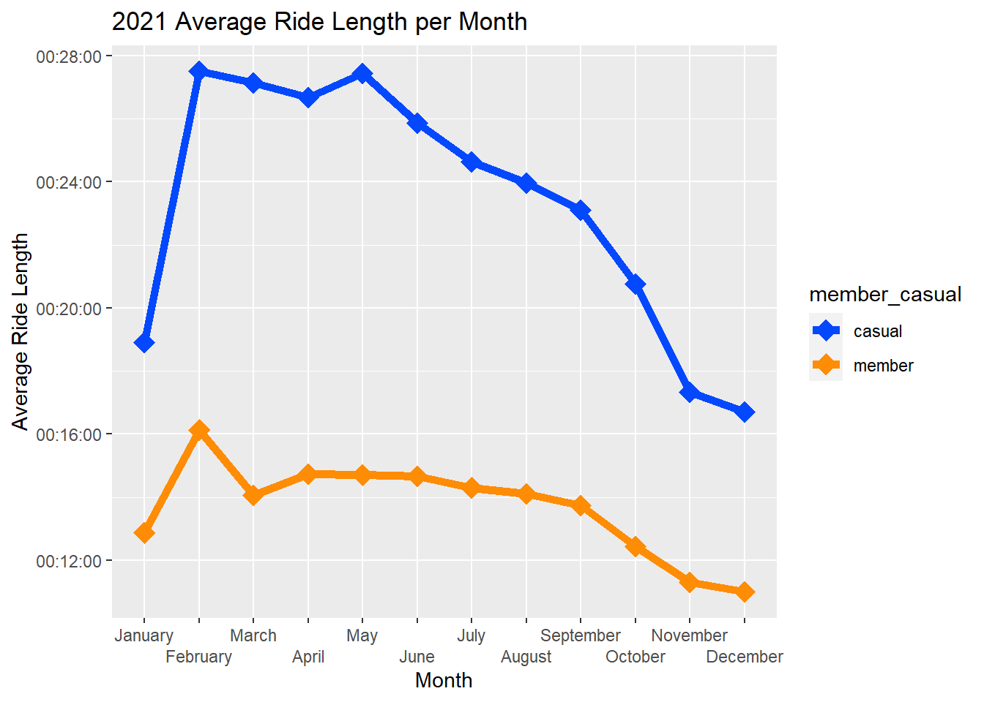
Visualization: Average Ride Length
Casual riders have longer average ride lengths than members

Slide 12
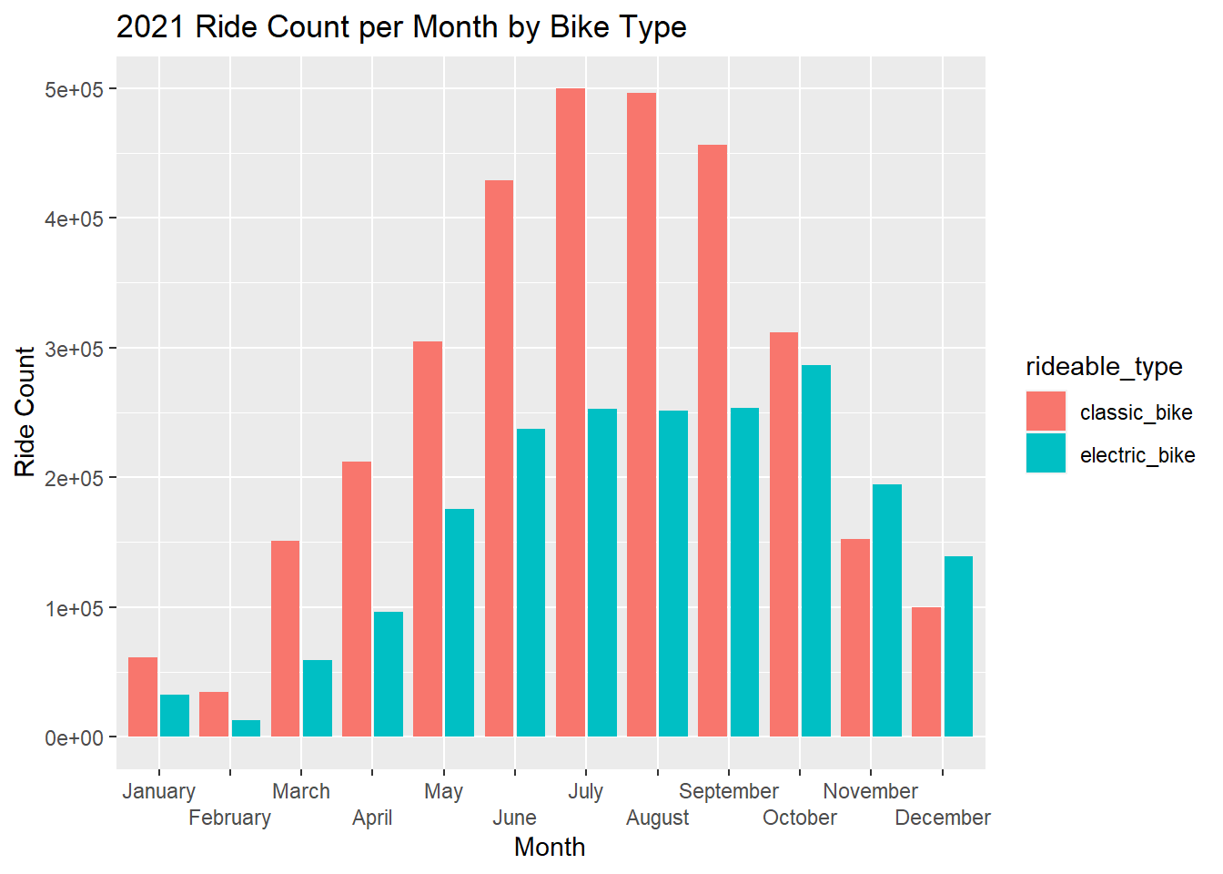
Visualization: Ride Count by Bike Type
Both rider types prefer “classic” bike

Slide 13
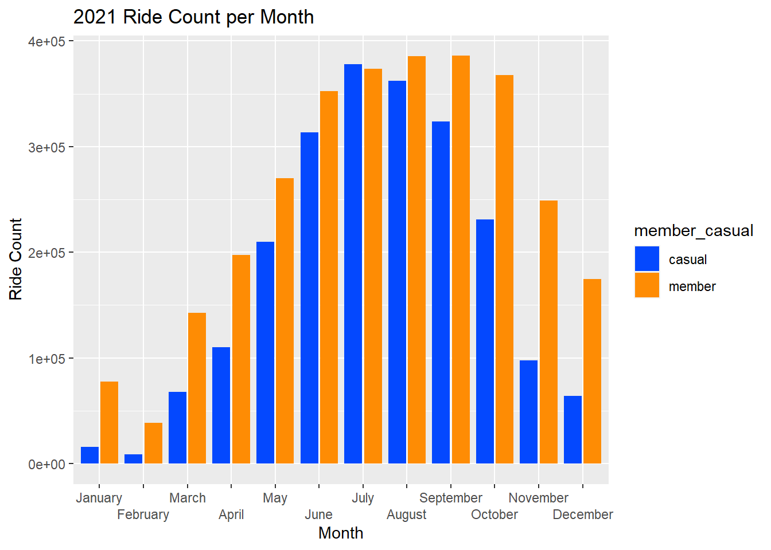
Visualization: Ride Count by Month
Ride count for casual and members peaks in 3Q

Slide 14
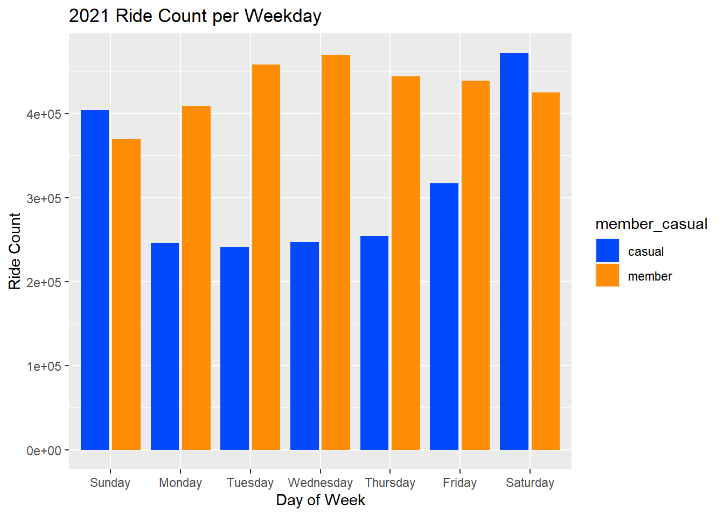
Visualization: Ride Count by Day
Casual riders ride count peaks on weekends while member demand is fairly consistent throughout week

Slide 15
Conclusion

Slide 16
Conclusion
Based on this analysis, we’ve identified three (3) differences between casual and member customers
Casual members:
Demand for bikes peaks on the weekend while member demand is fairly consistent throughout the week
Demand for bikes peaks slightly early in the year (July vs. September) versus member riders
Note that both (casual/member) experience demand greater than average from May-November
Spend more time on average on the rented bike versus member riders

Slide 17
Recommendations
Based on the analysis and conclusions, in order to maximize annual membership, it is recommended to:
Run targeted campaign on the weekends maximize casual riders customer pool
Run targeted campaign in spring/summer to maximize casual riders customer pool
Possibly run targeted campaign on classic bikes to maximize casual riders customer pool

Slide 18
Future Steps
Investigate the cause of the negative ride length spike in November 2021
Investigate ride lengths that last over 1 day
Review previous years data to confirm if trends identified during the 2021 analysis are valid. The COVID-19 pandemic may have strewed the 2020 and 2021 data
Conduct survey to better understand customer preference for classic bike

Slide 19
Appendix

Slide 20
Additional Information
An interactive dashboard can be found on Tableau located here.
The raw and clean dataset can be found on Kaggle located here.
The documentation for this analysis can be found on GitHub located here.

